Slide 1

Power Consumption of Tetouan City: A Comparison of Linear Regression and Linear SVC Models
Yashwanth Reddy Boddireddy | 31612593 | DS644

Slide 2

Project details
Models to be compared: Linear regression and Linear SVC
Model parameters that were varied: C regularization, Learning Rate.
Dataset: https://archive.ics.uci.edu/static/public/849/power+consumption+of+tetouan+city.zip
Dataset source: Power consumption of Tetouan city - UCI Machine Learning Repository
Dataset type: Tabular Data with 52416 rows and 9 columns.
Data Columns: DateTime, Temperature, Humidity, Wind Speed, general diffuse flows, diffuse flows, Zone 1 Power Consumption, Zone 2 Power Consumption, Zone 3 Power Consumption
Accuracy metric: Accuracy
Cross validation: 5-fold

Slide 3
Data preprocessing
There are no missing values and nan values in the dataset.
Did setting index to DateTime for better visualization
Renamed some columns
Produced some columns
Extracted dates and time from DateTime into separate columns.

Slide 4
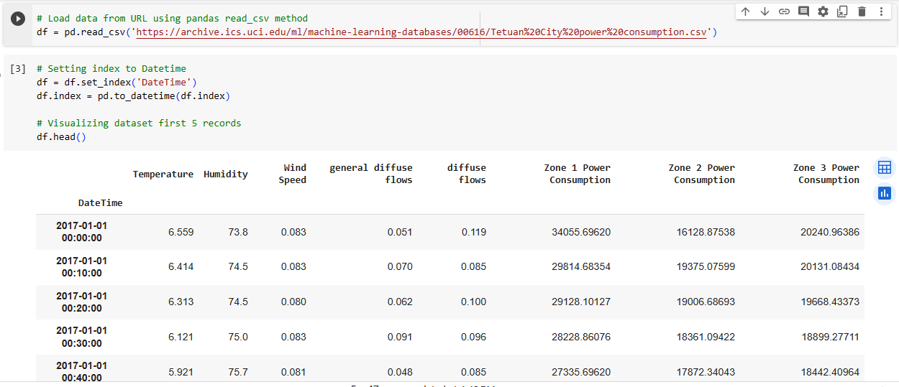
Code and Results:

Slide 5
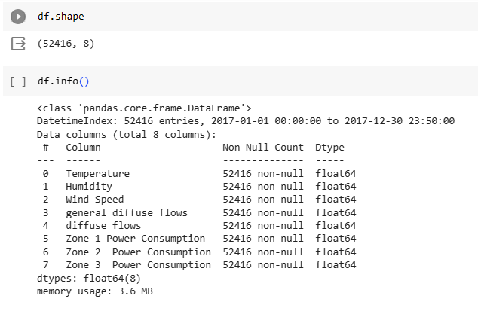
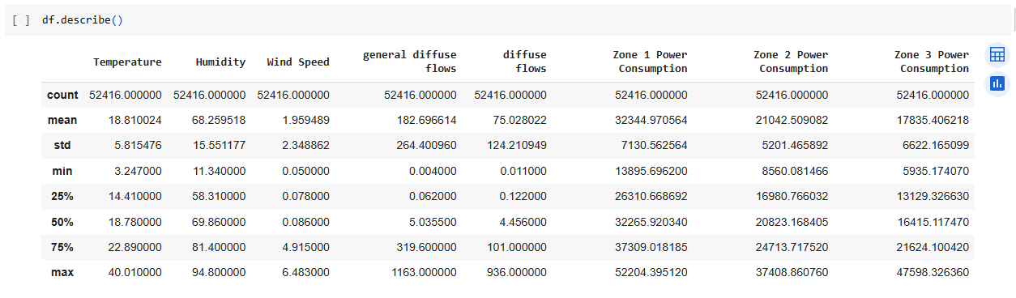

Slide 6
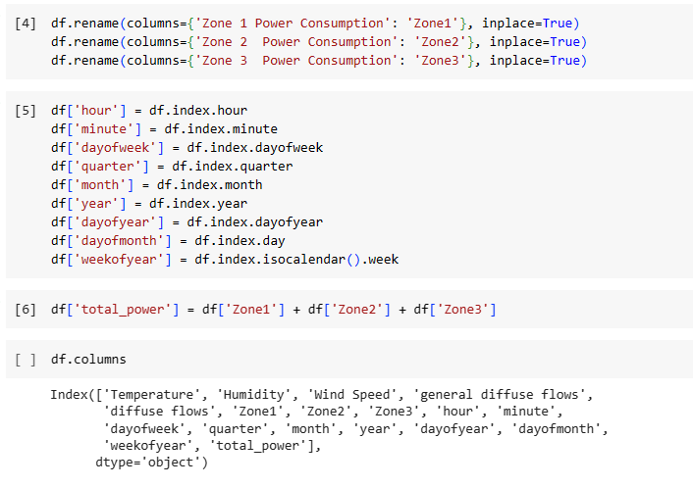
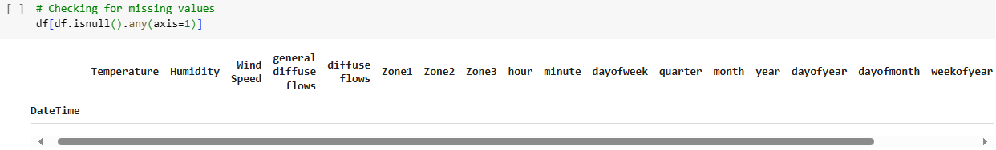

Slide 7
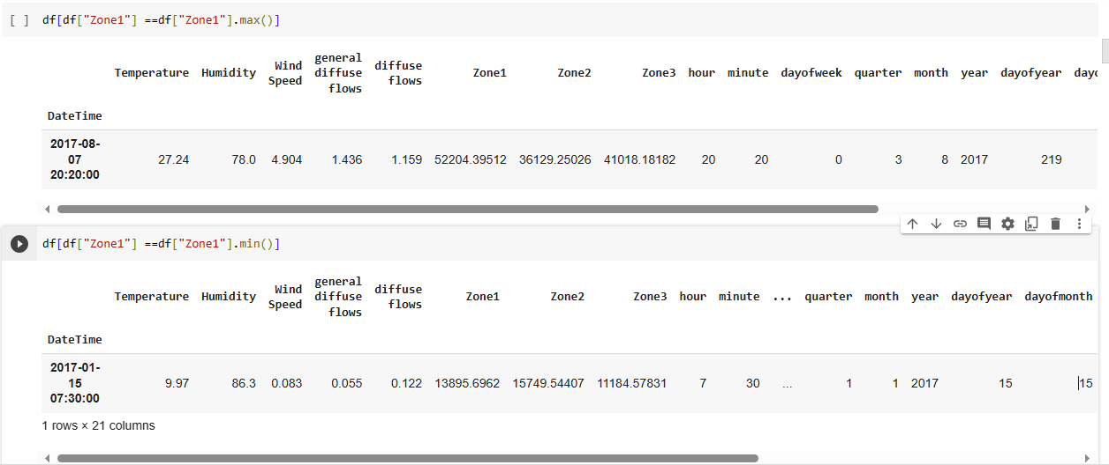

Slide 8
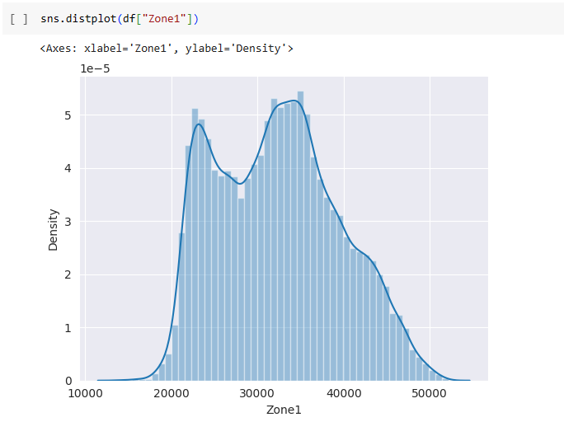
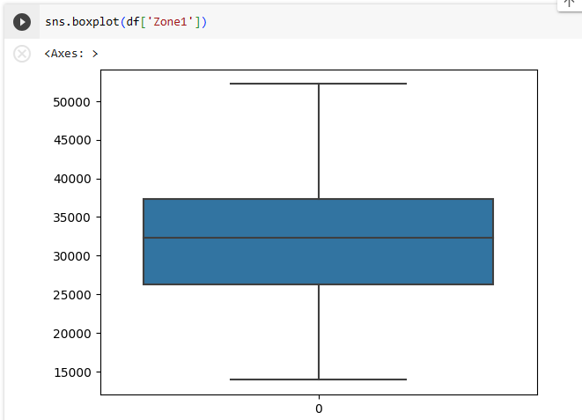

Slide 9
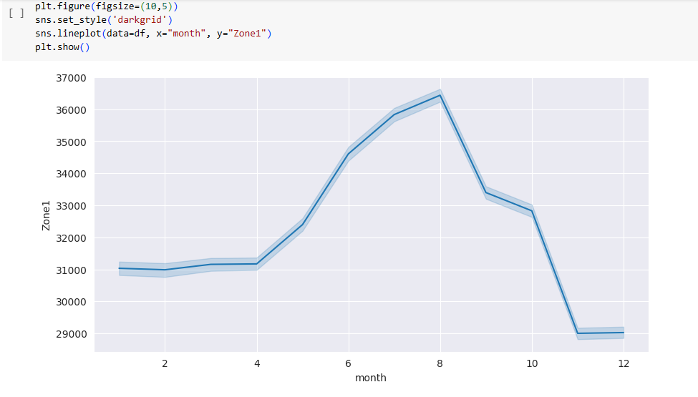

Slide 10
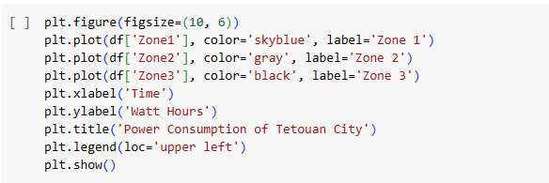
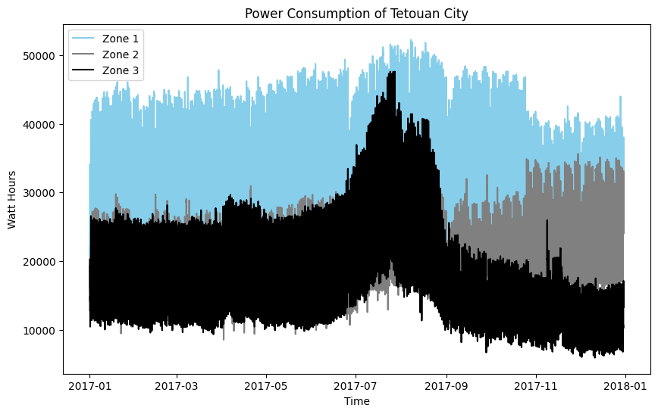

Slide 11
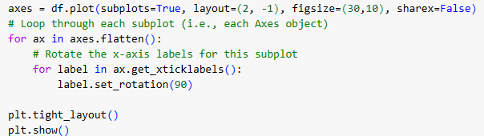
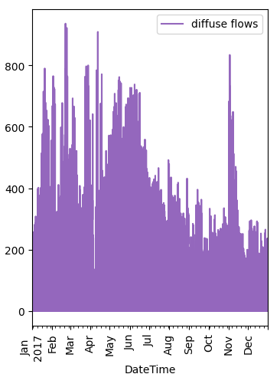
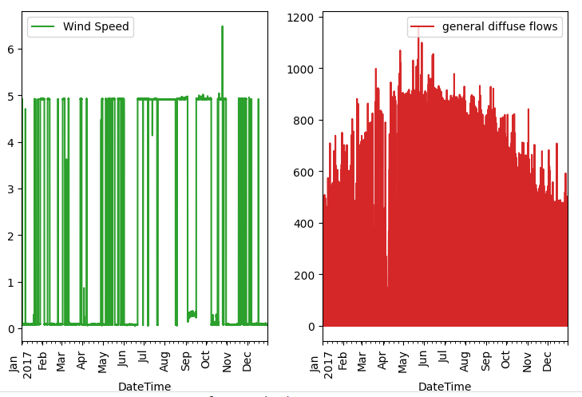
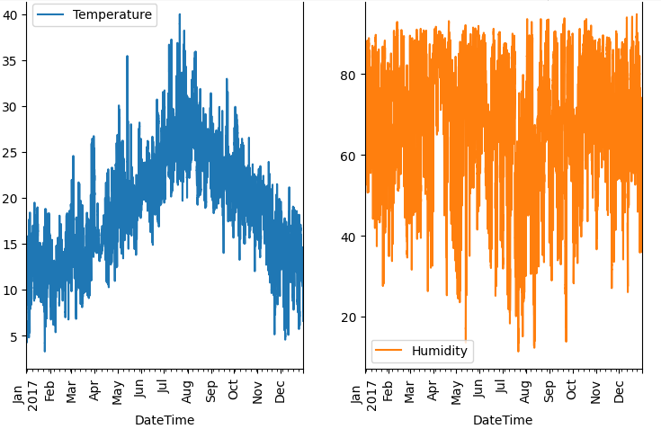

Slide 12
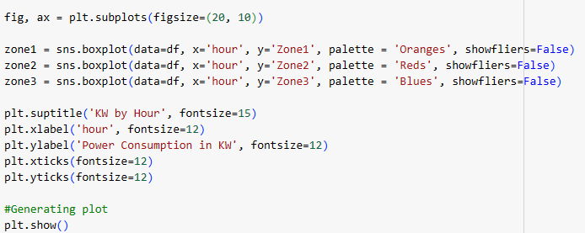
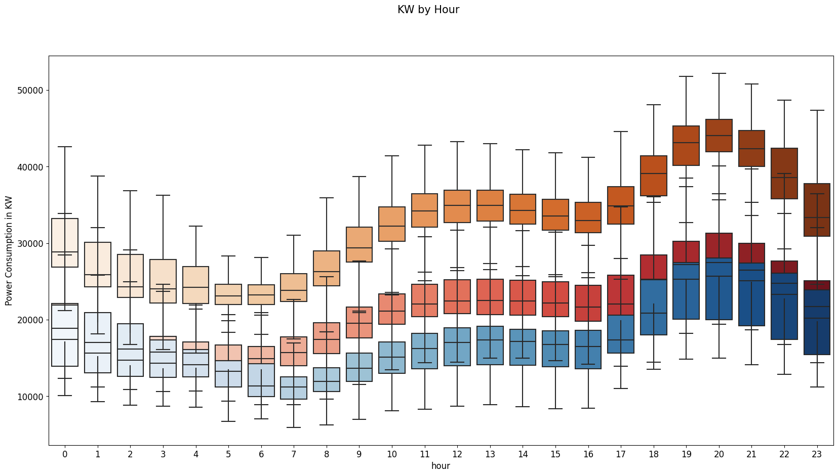

Slide 13
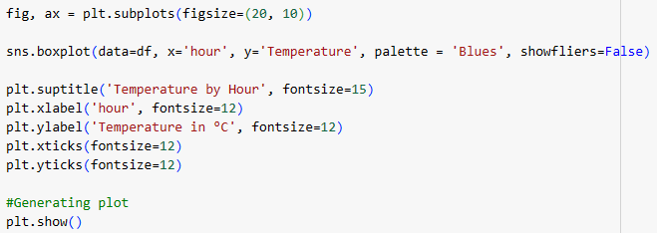
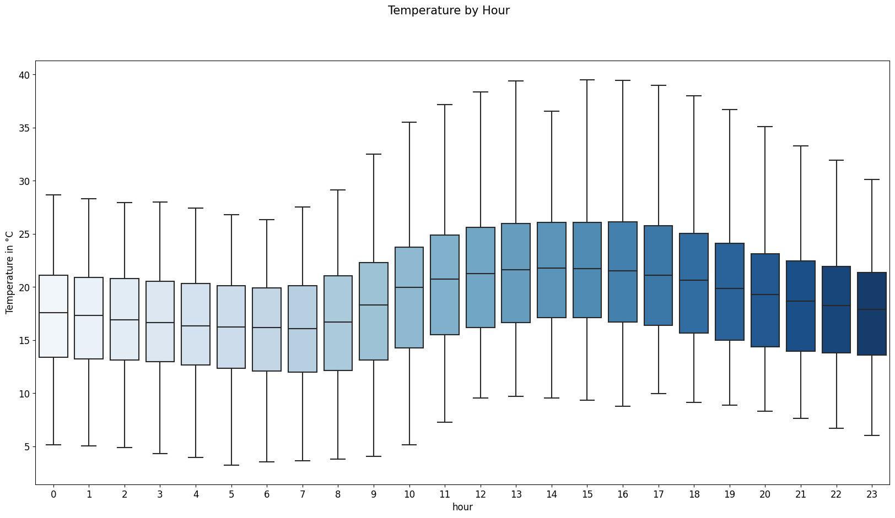

Slide 14
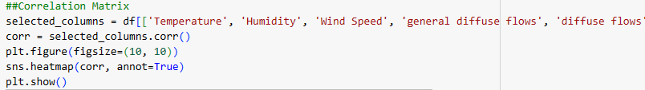
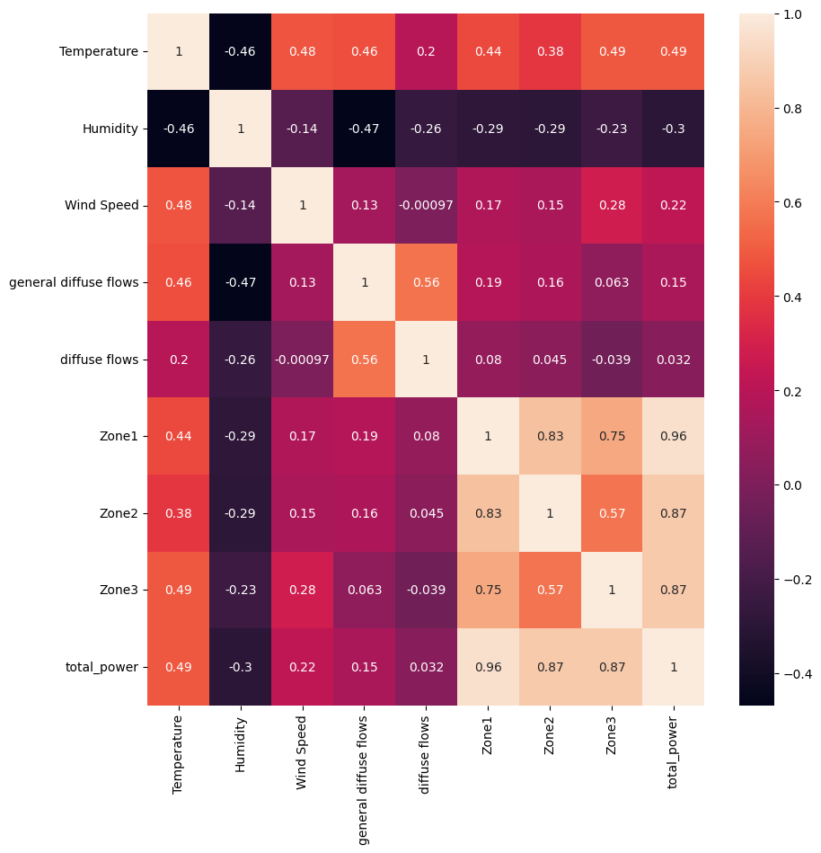

Slide 15
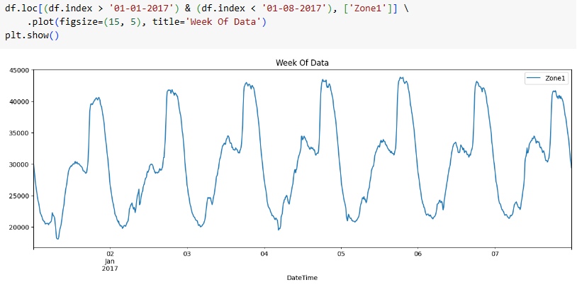
Zone1 power consumption for 1st Week of Jan 2017

Slide 16
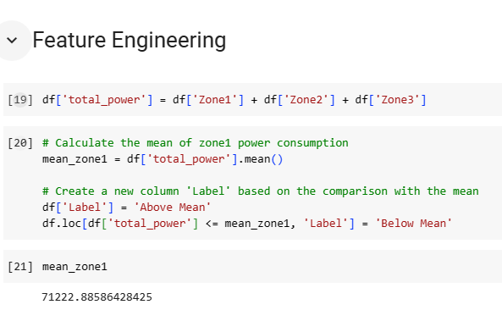

Slide 17
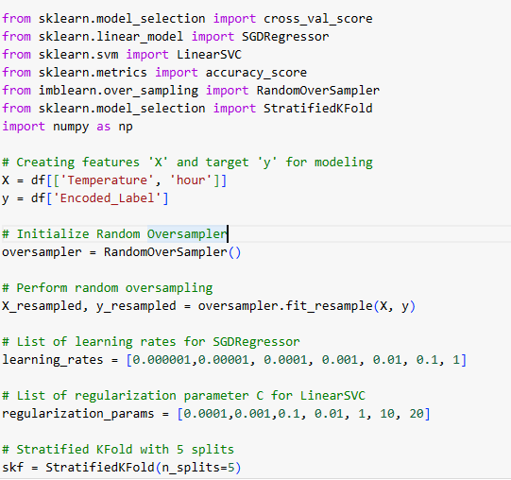
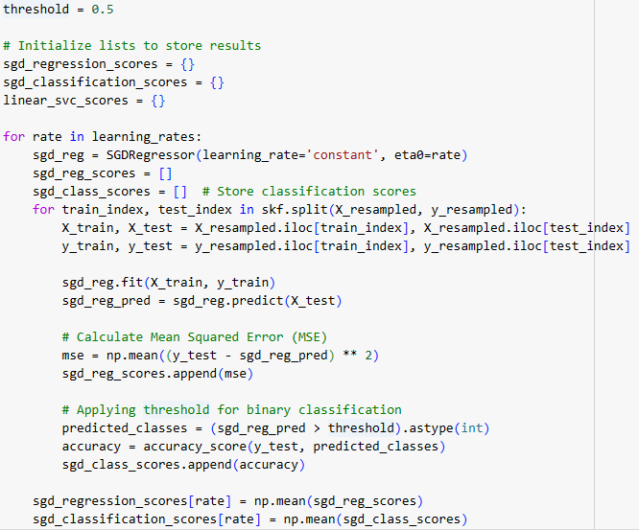
Model Training of Linear Regression(SGDRegressor) and Linear SVC

Slide 18
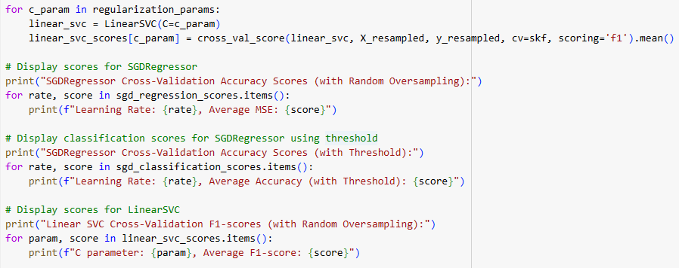
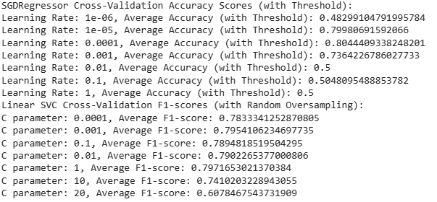

Slide 19
Results1:
The best average accuracy score was achieved with a learning rate of 1e-04 (0.8044). The accuracy scores are relatively stable across different learning rates, except for the lowest and highest learning rates. This suggests that the SGDRegressor model is not very sensitive to the choice of learning rate in this case.
For LinearSVC, the F1-scores seem relatively stable across different values of the regularization parameter C, with a peak around 1. We can consider narrowing down the search space for C or performing further fine-tuning around this range to refine the performance of the model.

Slide 20
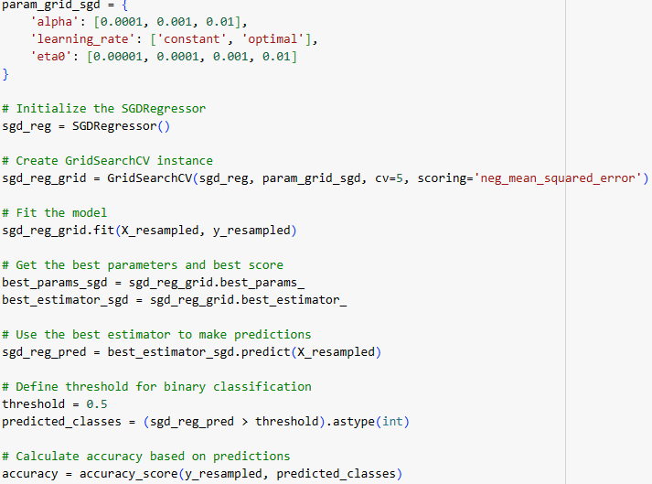
Linear regression with GridSearchCV

Slide 21
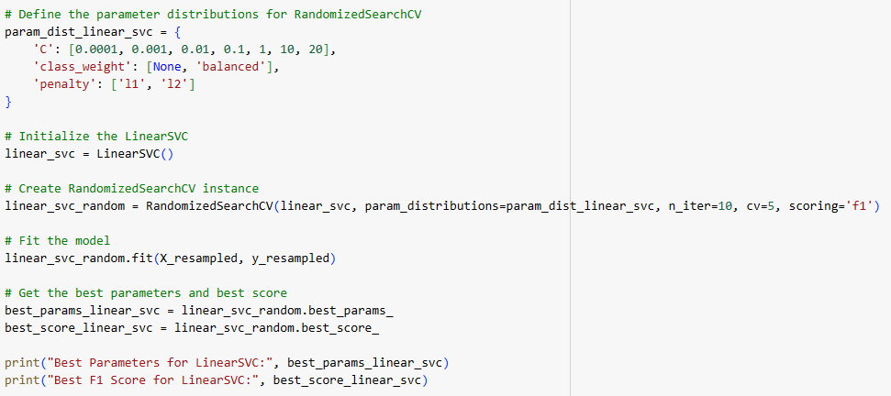
Linear SVC model training with RandomizedSearchCV

Slide 22
Results2:
Comparing the performance between these models, the LinearSVC seems to have a higher F1 score, indicating a better balance between precision and recall for the given classes compared to the accuracy of the SGDRegressor with threshold-based classification.

Slide 23
Conclusion:
The best average accuracy score was achieved with a learning rate of 1e-04 (0.8044). The accuracy scores are relatively stable across different learning rates, except for the lowest and highest learning rates. This suggests that the SGDRegressor model is not very sensitive to the choice of learning rate in this case.
For LinearSVC, the F1-scores are relatively consistent across C values, but the peak performance is seen around C=1. This suggests that the model performs well with moderate regularization.
Find my code here :https://github.com/yashwanthreddy7178/bigdataproject

Slide 24
Next Steps:
Integrating external data for Beter analysis.
Implementing with different machine learning models.
Apply the same study to different cities or a distribution network.
Financial study to measure the economic impact to configure power supply based on forecasts.
Real time model performance and improvement

Slide 25
References:
Salam, A., & El Hibaoui, A. (2018, December). Comparison of Machine Learning Algorithms for the Power Consumption Prediction:-Case Study of Tetouan city–. In 2018 6th International Renewable and Sustainable Energy Conference (IRSEC) (pp. 1–5). IEEE.
robikscube. (2022, July 5). Time Series Forecasting with Machine Learning [YT]. Retrieved September 29, 2022, from Kaggle.com website: https://www.kaggle.com/code/robikscube/time-series-forecasting-with-machine-learning-yt

Slide 26

Thank You
Q&A

